Slide 1

NBKR Institute Of Science and Technology
Bus Seat Booking System
SUJITH VARDHAN 24KB1A05LY
VEGURU SIMHADRI 24KB1A05NE
BRAMA UDAY 24KB1A05PC

Slide 2

College Event Registration System
A comprehensive C program that manages college events and student registrations using circular linked lists and dynamic memory allocation. This system allows administrators to add events, register students, remove students, and display all event information through an intuitive menu-driven interface.
vs
by veguru sinhadri

Slide 3






System Overview
User Interface
Menu-driven console application
Data Structures
Circular linked lists & dynamic memory
Core Functionality
Event & student management operations
The system is built using C programming language with standard libraries for input/output operations, memory management, and string manipulation. It employs a circular linked list to store events and a simple linked list to store students within each event, providing efficient traversal and management of data.

Slide 4
Data Structures
Student Structure
Event Structure
Each student node contains:
Each event node contains:
Integer student ID
Character array for event name
Character array for name
Pointer to student list head
Pointer to next student
Pointer to next event
Students form a simple linked list within each event, allowing for sequential access and management.
Events form a circular linked list, enabling continuous traversal through all events without reaching a null terminator.

Slide 5




Helper Functions
createEvent()
createStudent()
Allocates memory for a new event node, initializes its fields with the provided name, and sets student list and next pointers to NULL. Returns the newly created event node.
Allocates memory for a new student node, initializes its ID and name fields with provided values, and sets the next pointer to NULL. Returns the newly created student node.
freeMemory()
Traverses through all events and their associated student lists, freeing allocated memory to prevent memory leaks when the program terminates.

Slide 6




Core Operations
addEvent()
Adds a new event to the circular linked list. If it's the first event, it points to itself to form a circle. Otherwise, it's added at the end of the list while maintaining the circular structure.
addStudentToEvent()
Locates the specified event and adds a new student to its student list. If it's the first student, it becomes the head of the list. Otherwise, it's added at the end of the list.
removeStudentFromEvent()
Finds the specified event and removes the student with the given ID from its student list. Handles cases for removing the head student or a middle/last student.
displayEvents()
Traverses through all events in the circular linked list and displays each event's name along with its registered students' details.

Slide 7








Main Function Implementation
Display Menu
Get User Choice
Shows available options to the user
Captures user input for menu selection
Continue Loop
Process Selection
Returns to menu until exit is selected
Executes the corresponding function
The main function implements a while loop that continuously displays the menu options, captures the user's choice, and executes the corresponding operation through a switch statement. This creates an intuitive interface for users to interact with the system until they choose to exit, at which point all allocated memory is freed.

Slide 8



Sample Program Execution
Add Event: "Freshers Party"
User creates a new event in the system
2
Add Students: Ankit Sharma (ID: 101) and Priya Singh (ID: 102)
Two students are registered for the Freshers Party
Display Events: Shows Freshers Party with both registered students
System displays all events and their registered students
4
Remove Student: Ankit Sharma (ID: 101)
One student is removed from the event
Display Events Again: Shows Freshers Party with only Priya Singh
System confirms the removal by displaying updated information

Slide 9
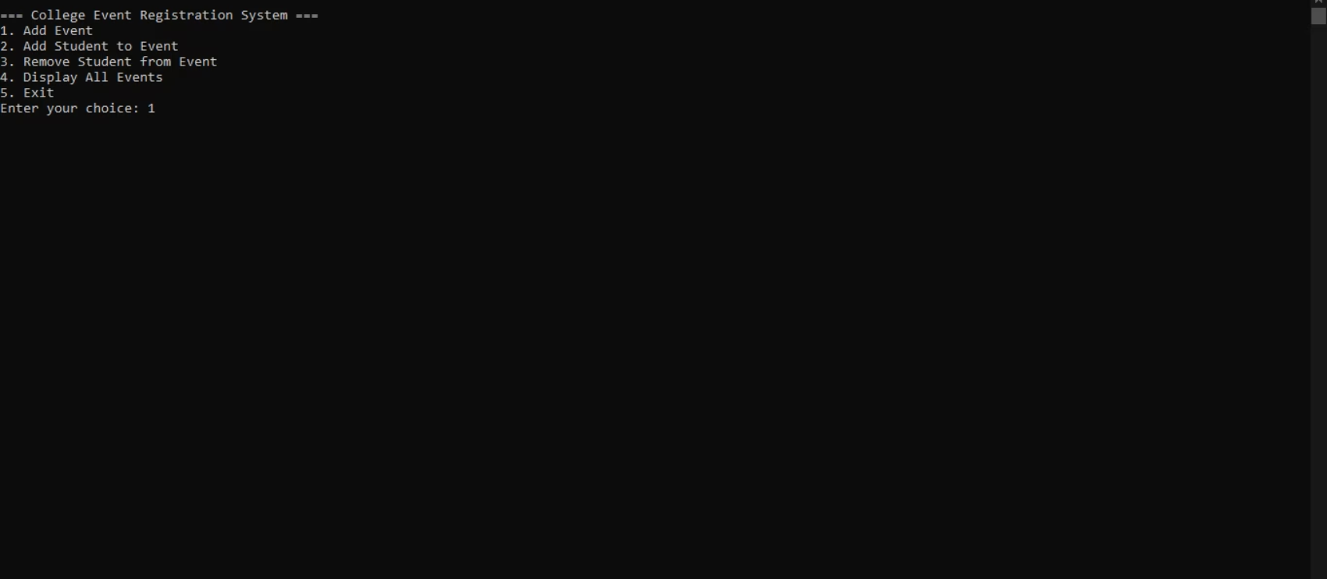
OUTPUT:

Slide 10
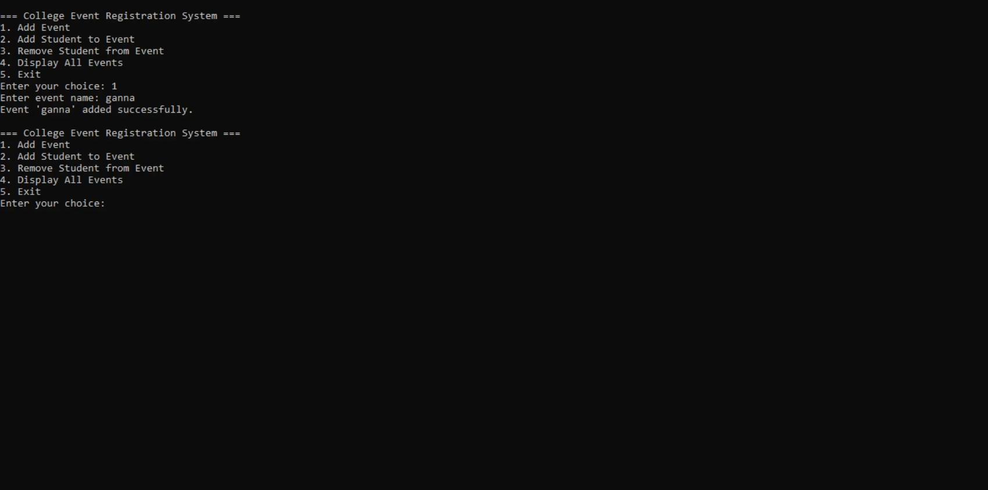

Slide 11
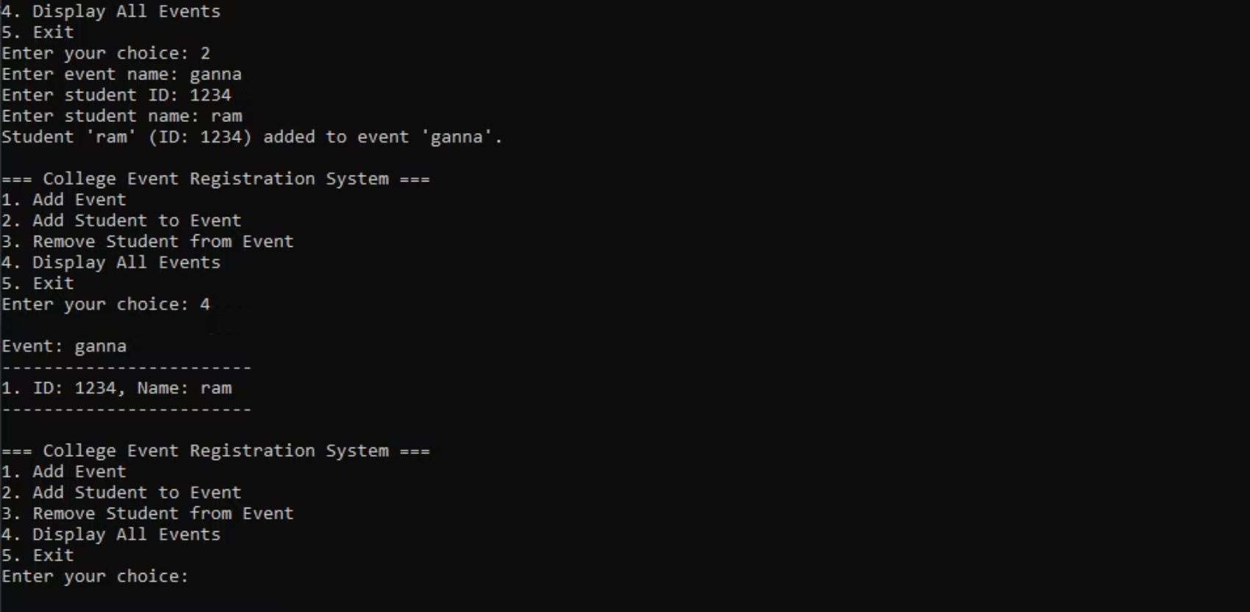

Slide 13
